Slide 1
Another look at Bayesian inference
A general scenario:
Query variables: X
Evidence (observed) variables and their values: E = e
Unobserved variables: Y
Inference problem: answer questions about the query variables given the evidence variables
This can be done using the posterior distribution P(X | E = e)
In turn, the posterior needs to be derived from the full joint P(X, E, Y)
Bayesian networks are a tool for representing joint probability distributions efficiently
Notes:
1

Slide 2


Bayesian networks
More commonly called graphical models
A way to depict conditional independence relationships between random variables
A compact specification of full joint distributions

Slide 3
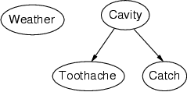
Bayesian networks: Structure
Nodes: random variables
Arcs: interactions
An arrow from one variable to another indicates direct influence
Must form a directed, acyclic graph

Slide 4
Example: N independent coin flips
Complete independence: no interactions
…
X₁
X₂
X_{n}

Slide 5
Example: Naïve Bayes document model
Random variables:
X: document class
W₁, …, W_{n}: words in the document
X
…
W₁
W₂
W_{n}

Slide 6
Example: Burglar Alarm
I have a burglar alarm that is sometimes set off by minor earthquakes. My two neighbors, John and Mary, promised to call me at work if they hear the alarm
Example inference tasks
Suppose Mary calls and John doesn’t call. What is the probability of a burglary?
Suppose there is a burglary and no earthquake. What is the probability of John calling?
Suppose the alarm went off. What is the probability of burglary?
…

Slide 7
Example: Burglar Alarm
I have a burglar alarm that is sometimes set off by minor earthquakes. My two neighbors, John and Mary, promised to call me at work if they hear the alarm
What are the random variables?
Burglary, Earthquake, Alarm, John, Mary
What are the direct influence relationships?
A burglar can set the alarm off
An earthquake can set the alarm off
The alarm can cause Mary to call
The alarm can cause John to call

Slide 8
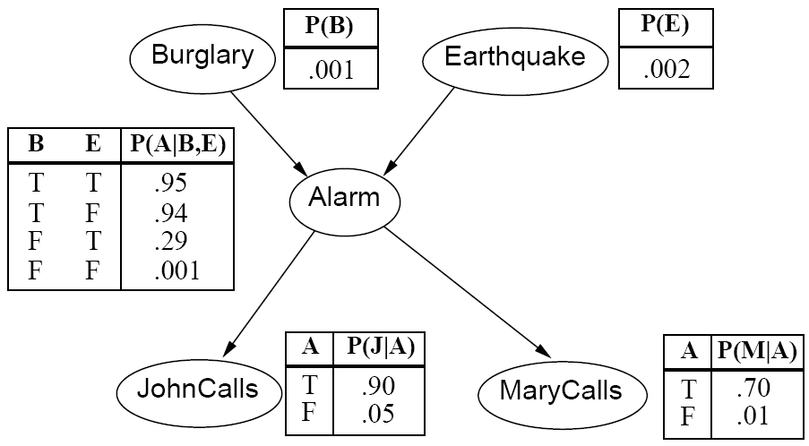
Example: Burglar Alarm

Slide 9
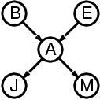
Conditional independence relationships
Suppose the alarm went off. Does knowing whether there was a burglary change the probability of John calling?
P(John | Alarm, Burglary) = P(John | Alarm)

Slide 10
Conditional independence relationships
Suppose the alarm went off. Does knowing whether there was a burglary change the probability of John calling?
P(John | Alarm, Burglary) = P(John | Alarm)
Suppose the alarm went off. Does knowing whether John called change the probability of Mary calling?
P(Mary | Alarm, John) = P(Mary | Alarm)

Slide 11
Conditional independence relationships
Suppose the alarm went off. Does knowing whether there was a burglary change the probability of John calling?
P(John | Alarm, Burglary) = P(John | Alarm)
Suppose the alarm went off. Does knowing whether John called change the probability of Mary calling?
P(Mary | Alarm, John) = P(Mary | Alarm)
Suppose the alarm went off. Does knowing whether there was an earthquake change the probability of burglary?
P(Burglary | Alarm, Earthquake) != P(Burglary | Alarm)

Slide 12
Conditional independence relationships
Suppose the alarm went off. Does knowing whether there was a burglary change the probability of John calling?
P(John | Alarm, Burglary) = P(John | Alarm)
Suppose the alarm went off. Does knowing whether John called change the probability of Mary calling?
P(Mary | Alarm, John) = P(Mary | Alarm)
Suppose the alarm went off. Does knowing whether there was an earthquake change the probability of burglary?
P(Burglary | Alarm, Earthquake) != P(Burglary | Alarm)
Suppose there was a burglary. Does knowing whether John called change the probability that the alarm went off?
P(Alarm | Burglary, John) != P(Alarm | Burglary)

Slide 13
Conditional independence relationships
John and Mary are conditionally independent of Burglary and Earthquake given Alarm
Children are conditionally independent of ancestors given parents

Slide 14
Conditional independence relationships
John and Mary are conditionally independent of Burglary and Earthquake given Alarm
Children are conditionally independent of ancestors given parents
John and Mary are conditionally independent of each other given Alarm
Siblings are conditionally independent of each other given parents

Slide 15
Conditional independence relationships
John and Mary are conditionally independent of Burglary and Earthquake given Alarm
Children are conditionally independent of ancestors given parents
John and Mary are conditionally independent of each other given Alarm
Siblings are conditionally independent of each other given parents
Burglary and Earthquake are not conditionally independent of each other given Alarm
Parents are not conditionally independent given children

Slide 16
Conditional independence relationships
John and Mary are conditionally independent of Burglary and Earthquake given Alarm
Children are conditionally independent of ancestors given parents
John and Mary are conditionally independent of each other given Alarm
Siblings are conditionally independent of each other given parents
Burglary and Earthquake are not conditionally independent of each other given Alarm
Parents are not conditionally independent given children
Alarm is not conditionally independent of John and Mary given Burglary and Earthquake
Nodes are not conditionally independent of children given parents
General rule: each node is conditionally independent of its non-descendants given its parents

Slide 17
Conditional independence and the joint distribution
General rule: each node is conditionally independent of its non-descendants given its parents
Suppose the nodes X₁, …, X_{n} are sorted in topological order (parents before children)
To get the joint distribution P(X₁, …, X_{n}), use chain rule:

Slide 18
Conditional probability distributions
To specify the full joint distribution, we need to specify a conditional distribution for each node given its parents: P (X | Parents(X))
…
Z₁
Z₂
Z_{n}
X
P (X | Z₁, …, Z_{n})

Slide 19
Example: Burglar Alarm
The conditional probability tables are the model parameters

Slide 20
The joint probability distribution
For example, P(j, m, a, ¬b, ¬e)
= P(¬b) P(¬e) P(a | ¬b, ¬e) P(j | a) P(m | a)

Slide 21
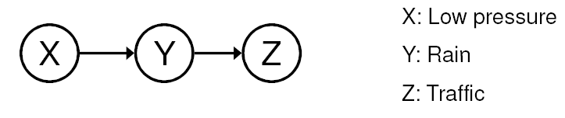
Conditional independence
General rule: X is conditionally independent of every non-descendant node given its parents
Example: causal chain
Are X and Z independent?
Is Z independent of X given Y?

Slide 22
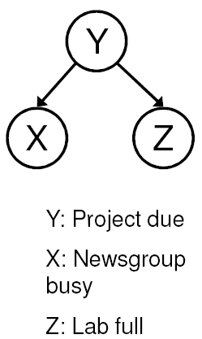
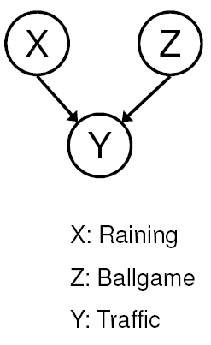
Conditional independence
Common cause
Are X and Z independent?
No
Are they conditionally independent given Y?
Yes
Common effect
Are X and Z independent?
Yes
Are they conditionally independent given Y?
No
Notes:
Is P(Raining | Traffic) the same as P(Raining | Traffic, Ballgame)?

Slide 23
Compactness
Suppose we have a Boolean variable X_{i} with k Boolean parents. How many rows does its conditional probability table have?
2^{k} rows for all the combinations of parent values
Each row requires one number for P(X_{i} = true | parent values)
If each variable has no more than k parents, how many numbers does the complete network require?
O(n · 2^{k}) numbers – vs. O(2^{n}) for the full joint distribution
How many nodes for the burglary network?
1 + 1 + 4 + 2 + 2 = 10 numbers (vs. 2⁵-1 = 31)

Slide 24
Constructing Bayesian networks
Choose an ordering of variables X₁, … , X_{n}
For i = 1 to n
add X_{i} to the network
select parents from X₁, … ,X_{i-1} such that P(X_{i} | Parents(X_{i})) = P(X_{i} | X₁, ... X_{i-1})

Slide 25
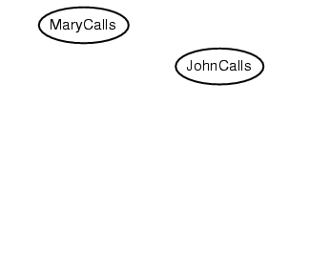
Example
Suppose we choose the ordering M, J, A, B, E

Slide 26
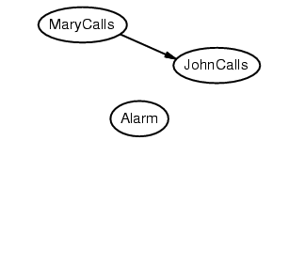
Example
Suppose we choose the ordering M, J, A, B, E

Slide 27
Example
Suppose we choose the ordering M, J, A, B, E

Slide 28
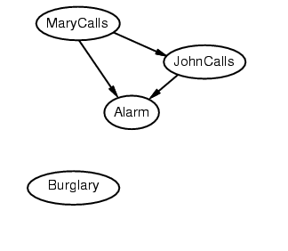
Example
Suppose we choose the ordering M, J, A, B, E

Slide 29
Example
Suppose we choose the ordering M, J, A, B, E

Slide 30
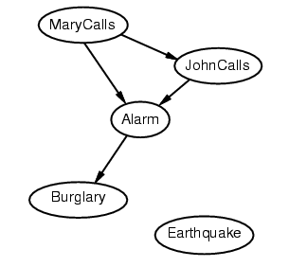
Example
Suppose we choose the ordering M, J, A, B, E

Slide 31
Example
Suppose we choose the ordering M, J, A, B, E

Slide 32
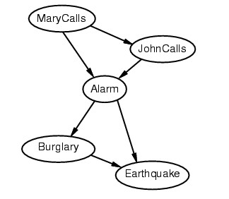
Example
Suppose we choose the ordering M, J, A, B, E

Slide 33
Example contd.
Deciding conditional independence is hard in noncausal directions
The causal direction seems much more natural
Network is less compact: 1 + 2 + 4 + 2 + 4 = 13 numbers needed (vs. 10 for the causal ordering)

Slide 34
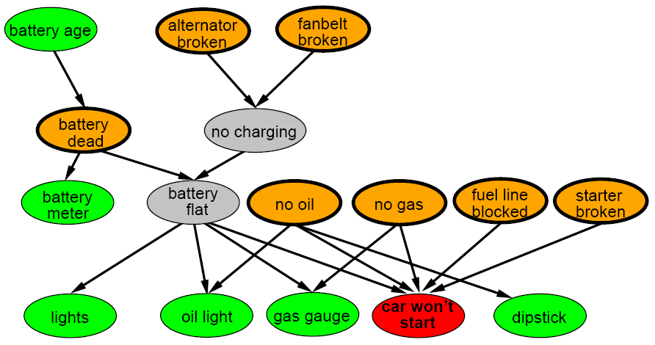
A more realistic Bayes Network: Car diagnosis
Initial observation: car won’t start
Orange: “broken, so fix it” nodes
Green: testable evidence
Gray: “hidden variables” to ensure sparse structure, reduce parameteres

Slide 35
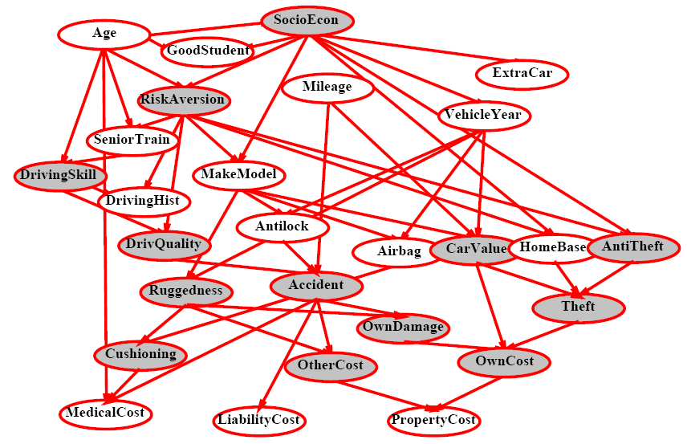
Car insurance

Slide 36
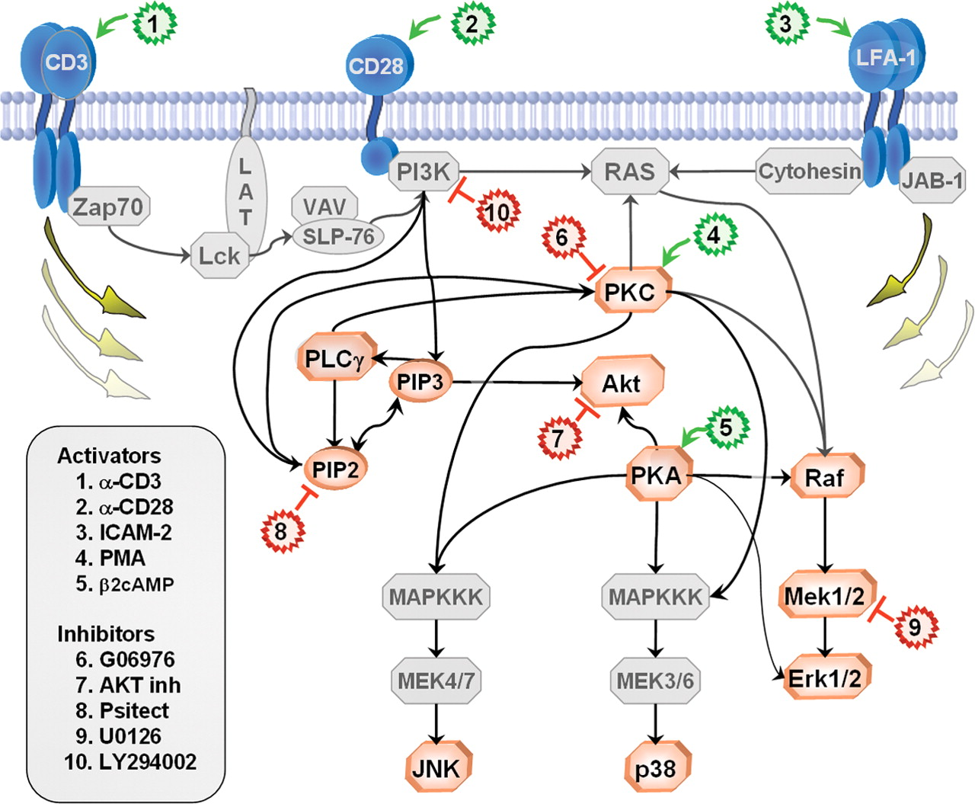
In research literature…
Causal Protein-Signaling Networks Derived from Multiparameter Single-Cell Data
Karen Sachs, Omar Perez, Dana Pe'er, Douglas A. Lauffenburger, and Garry P. Nolan
(22 April 2005) Science 308 (5721), 523.

Slide 37
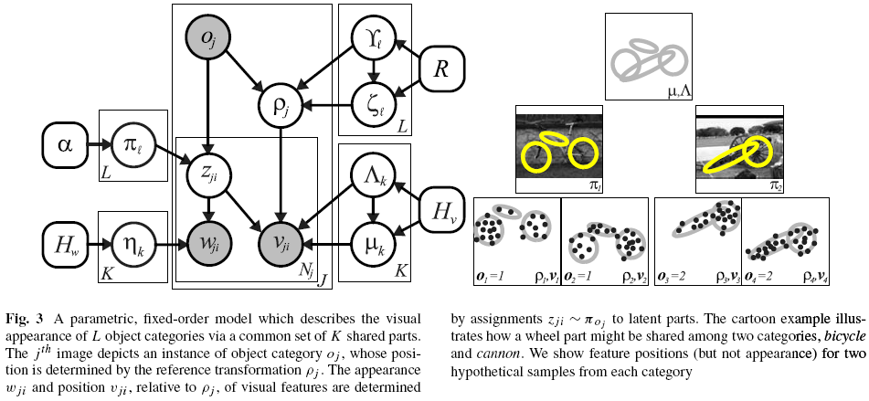
In research literature…
Describing Visual Scenes Using Transformed Objects and Parts
E. Sudderth, A. Torralba, W. T. Freeman, and A. Willsky.
International Journal of Computer Vision, No. 1-3, May 2008, pp. 291-330.

Slide 38
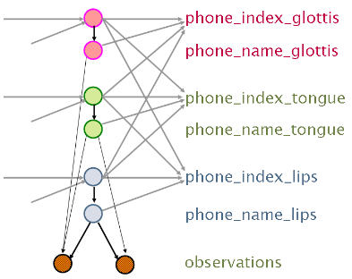
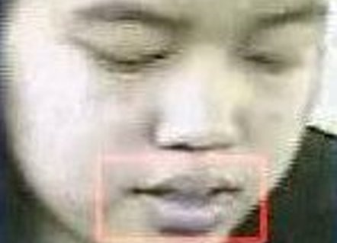
In research literature…
audio
video
Audiovisual Speech Recognition with Articulator Positions as Hidden Variables
Mark Hasegawa-Johnson, Karen Livescu, Partha Lal and Kate Saenko
International Congress on Phonetic Sciences 1719:299-302, 2007

Slide 39
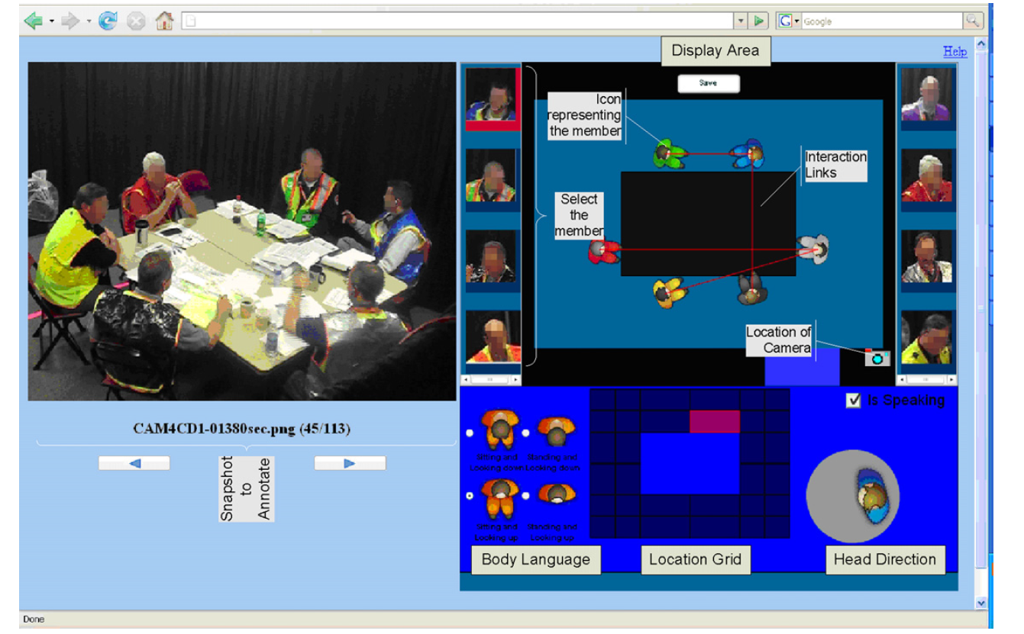
In research literature…
Detecting interaction links in a collaborating group using manually annotated data
S. Mathur, M.S. Poole, F. Pena-Mora, M. Hasegawa-Johnson, N. Contractor
Social Networks 10.1016/j.socnet.2012.04.002

Slide 40
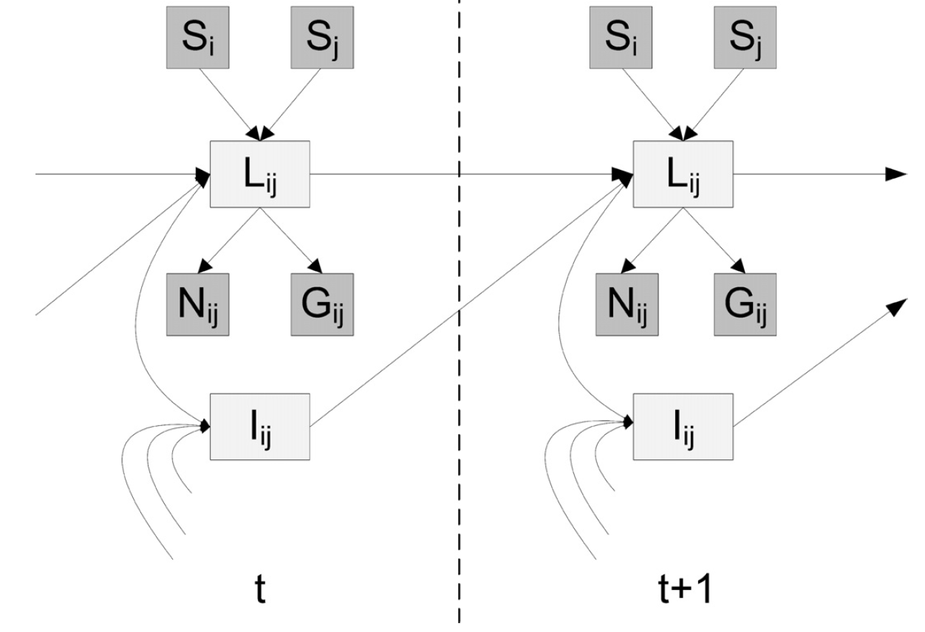
In research literature…
Speaking: S_{i}=1 if #i is speaking.
Link: L_{ij}=1 if #i is listening to #j.
Neighborhood: N_{ij}=1 if they are near one another.
Gaze: G_{ij}=1 if #i is looking at #j.
Indirect: I_{ij}=1 if #i and #j are both listening to the same person.
Detecting interaction links in a collaborating group using manually annotated data
S. Mathur, M.S. Poole, F. Pena-Mora, M. Hasegawa-Johnson, N. Contractor
Social Networks 10.1016/j.socnet.2012.04.002

Slide 41
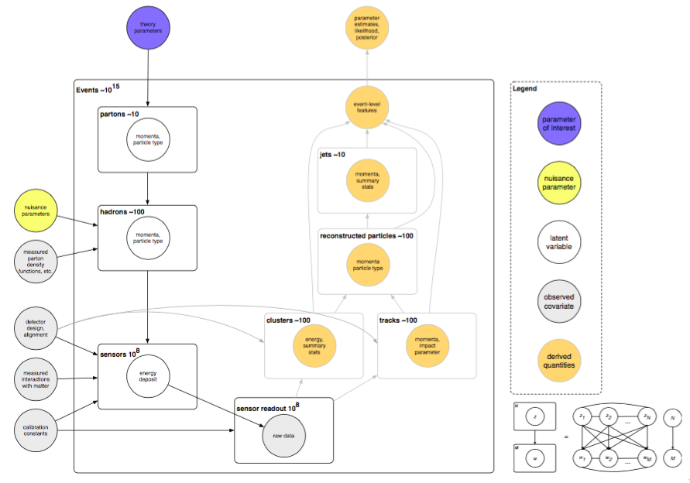
In research literature…
NIPS 2016 Keynote: Machine Learning & Likelihood Free Inference in Particle Physics, Kyle Cranmer

Slide 42
Summary
Bayesian networks provide a natural representation for (causally induced) conditional independence
Topology + conditional probability tables
Generally easy for domain experts to construct

